Slide 1


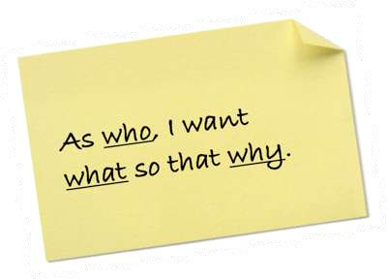
Better User Stories:
Have Your Cake and Eat it Too
Hosts:
Jeff Sutherland Joel Riddle
© 2011 Scrum Inc.
Inc.
Scrum 2014
©

Slide 2






Who We Are
Scrum Inc. is the Agile leadership company of Dr. Jeff Sutherland, co-creator of Scrum. We are based at the MIT Cambridge Innovation Center, MA.
CEO Jeff Sutherland helps companies achieve the full benefits of Scrum leading our comprehensive suite of support services and leadership training:
Adapting the methodology to an ever-expanding set of industries, processes and business challenges Training (Scrum Master, Product Owner, Agile Leadership, online courses, etc.)
Consulting (linking Scrum and business strategy, scaling Scrum)
Coaching (hands-on support to Scrum teams)
Chief Content Officer JJ Sutherland and Scrum Master Joel Riddle maintain the Scrum framework by:
Capturing and codifying evolving best practices (Scrum Guide)
Conducting original research on organizational behavior
Publishing (3 books) and productizing ScrumLab
President Scrum@Hardware Joe Justice leads our hardware consulting practice:
Worldwide consulting at leading hardware companies
700-800% performance improvement in hardware development
Builds 100 mpg cars in his garage with help from 500 people in 32 countries
We run our company using Scrum as the primary management framework, making us a living laboratory on the cutting edge of “Enterprise Scrum”
Find out more at www.scruminc.com.
©2014ScrumInc.

Slide 3
Agenda
•
Discuss what makes a “good” user story, and the importance of good user stories to Scrum
Introduce “Stacks” and vertical slicing of functionality
Share four tips for writing good independent user stories
Product decomposition
•
•
•
•
•
Modular architecture User stories, not tasks Sanity check often
•
Share several different examples of good user stories in different contexts
2
©2014ScrumInc.

Slide 4




Agile User Stories
Respond to Change
Delight the Customer
Agile Manifesto
Working Product
Great Teams
© 2006-2015 Scrum Inc.
4

Slide 5


The Four Horseman of the Apocalypse
Hierarchical Thinking
Not Ready Not Done
No Working Software
Layered Stories
Layered Teams
© 2006-2015 Scrum Inc.
Obamacare had no working stories at the beginning, in the middle, or at the end!
5

Slide 6

Symptoms of Bad User Stories
Wasted Time
Excessive effort to figure out what is really meant by the story
Additional research needed before work can start/end
Time spent waiting for external dependencies to be cleared
Product Issues
Back-end infrastructure built with nothing to show customer
Building something only to discover it is not what the customer really wanted
Overly prescriptive stories don’t leave room for innovation by the team
Quality Problems
Insufficient Definition of Done results in poor product quality
Sub-components of product developed by different teams don’t integrate well
Over-built features due to lack of clear acceptance criteria cause code bloat and product liability
©2014ScrumInc.

Slide 7
User Story Readiness Guidelines
Product vision
Product Backlog
✔ _{I}
mmediately
Can be delivered independently? Free from external blockage?
Descriptive enough to support team debate and conversation?
Delivers customer or business- visible benefit?
Clear enough that team can estimate?
Divided into small enough blocks to complete within Sprint?
Clear acceptance criteria to know when it is “good enough?”
actionable
✔ Negotiable
✔ Valuable
✔ Estimable
✔ Sized to fit
✔ Testable
Modified from Bill Wake – www.xp123.com
©2014ScrumInc.

Slide 8
User Story Readiness Progression
New Card Nursery
All inputs accepted
Promotion: Product Owner determines this story matches product goals
Elementary School
Analysts decompose
User experience experts research context
Business alignment needs identified
Promotion: Matches release goals
Increasing Readiness
Junior High
Card details, acceptance criteria, UI pre-­‐work (wireframes, visual and content prototypes
Legal & compliance issues reviewed
Promotion: Alignment with key stakeholders on features, functions, and visuals
High School
Ready for sprint
Candidates for Release Planning/Sprint Planning
Minimal refinement expected on core User Experience
©2014ScrumInc.

Slide 9

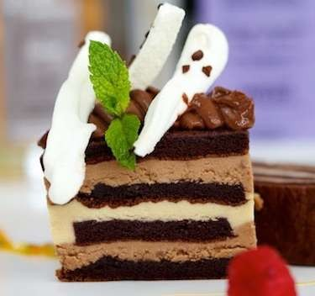








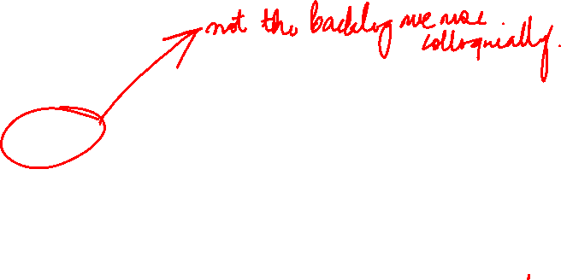
Not All Backlog Items are User Stories, But All User Stories Should be “Vertical Slices”
Backlog items include everything the team needs to do in one ordered set of activities
Wherever possible, backlog items should deliver complete vertical slices of functionality across work layers
Customer Features
Product Backlog
Architecture
Testing GUI
Client Server
DB Schema Detailed Design
Architecture
Team Infrastructure
Research
Risk Reduction
Some teams also choose to include process improvements, bugs and technical debt fixes explicitly as backlog items
©2014ScrumInc.

Slide 10

























Breaking the Stack into Independent Stories
All industries have “stacks”
A compelling user story delivers incremental value across stack layers
Route 1 Route 2 Route 3 Route 4/5
E.g. Air travel industry stack
Flight crew, ground crew, security
Aircraft
Food, fuel and baggage handling
Reservation & ticketing systems
Scheduling and routing tools
Runways and terminals
Air traffic control system
©2014ScrumInc.

Slide 11
Not All Features Are Created Equal!
80% of value typically
50
resides in 20% of features
Value to Customer
37.5
65% of features provide little to no value, are rarely used and/or aren’t actually desired by the customer
25
The rest are OK, but not as important
12.5
0
Features
How can you tell ahead of time which features add value and which don’t?
©2014ScrumInc.

Slide 12






Better
Delivering Customer Features Incrementally Can Drive Radically Better Value Delivery
200
180
160
140
120
100
80
60
40
20
Value (%)
10
20
30
40 50 60 70
Time, Cost, Features (%)
80
90
100
©2014ScrumInc.

Slide 13



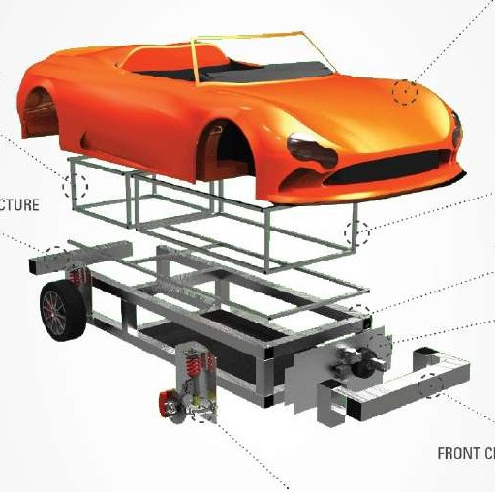











Four Tips for Writing User Stories as Independent Vertical Slices
Product
Feature Feature Epic Epic
1
Maintain and use clear product decomposition
Epic
Story Story Story
2
Leverage modular/agile architecture as a foundation
How? What?
3
Write User Stories, not Tasks
Why?
?!?
4
Conduct regular vertical slice “sanity checks” on all stories
T
T
PO
T
©2014ScrumInc.

Slide 14
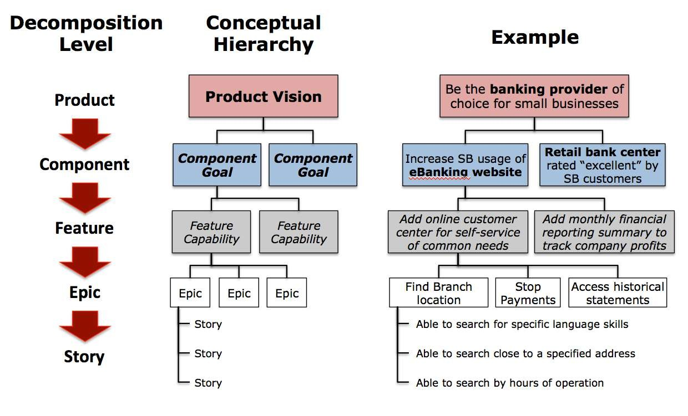
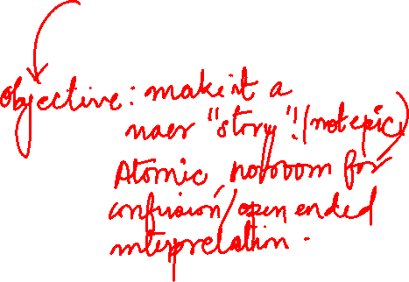
Maintain a Clear Product Decomposition Hierarchy
1
©2014ScrumInc.

Slide 15
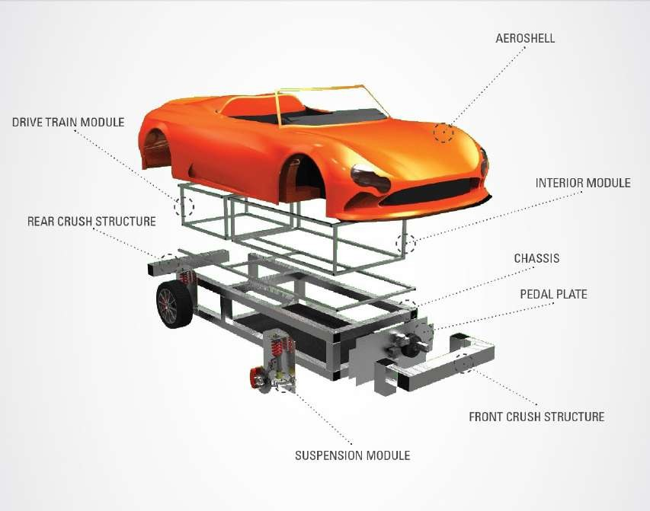
Modular/Agile Architecture Needs to Support Product Hierarchy!
2
Underlying structure is a set of largely independent modules with pre-defined interfaces
Interfaces remain stable, allowing everything within the module to change without impacting other modules
The 8 modules of the Wikispeed Car
Enables product design to “emerge” rapidly in response to inspect and adapt cycles
Also supports re-use of the same module for different contexts
©2014ScrumInc.

Slide 16
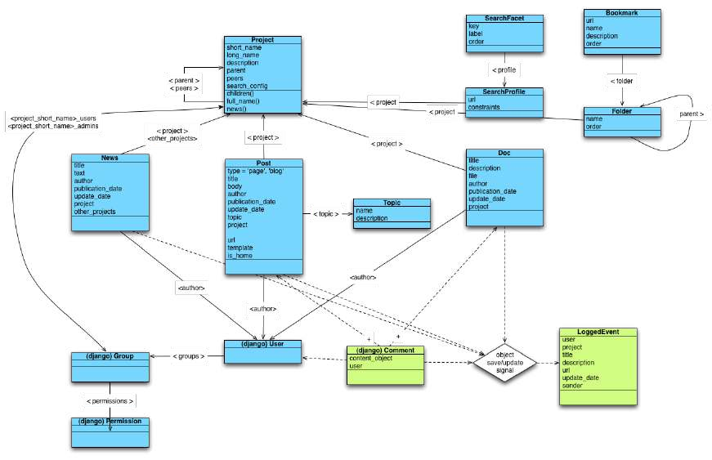
In Software, “Object Oriented” Modularity Has Been the Norm for a Long Time
2
•
•
•
•
•
•
Business components Message passing Information hiding Inheritance Polymorphism Refactoring
A type of user needs an object to do something to generate value!
©2014ScrumInc.

Slide 17













Write User Stories, Not Tasks
3
User Story
Task
Task
Task
Focuses on WHAT the team needs to do, and WHY they need to do it
Typically requires many team members with different skills to complete
Can be completed independent of other user stories
Focuses on HOW the team will accomplish their work
Typically can be done by one or two team members with similar skill sets
Often must be completed sequentially
Address individual development layers
How?
What?
Why?
Deliver independent customer visible value!
Do not deliver independent customer visible value!!
Confusing user stories with tasks unnecessarily limits the team’s ability to innovate, accelerate and try new approaches
©2014ScrumInc.

Slide 18











Conduct Regular “Sanity Checks”
4
Despite the best intentions, dependent or task- level stories invariably slip through…
?!?
Make time as a team to check stories in the backlog regularly
E.g. at Sprint Planning or Backlog Refinement
T
T
PO
T
✗
Customer visible value – does every story result in customer visible value? (customer not necessarily just an external user)
Swarming – does this story require multiple people to complete?
External Dependency – Is this story free from dependence on other stories or groups outside the team?
Test Driven Development – Does this story have clear and testable acceptance criteria?
If no then story probably isn’t independent
✗
If no then it probably isn’t a complete vertical slice
✗
If no then story probably isn’t independent
✗
If no then it probably isn’t a complete vertical slice
©2014ScrumInc.

Slide 19



Example 1: Books and Beyond
•
We are building an application for a business that sells products such as books, movies, music, and greeting cards. Assume a physical store.
Your Product Owner has a story: As a customer, I want to buy a product so that I can enjoy using it!
This story is a huge epic. The team needs to work with the product owner to split it.
•
•
©2014ScrumInc.

Slide 20
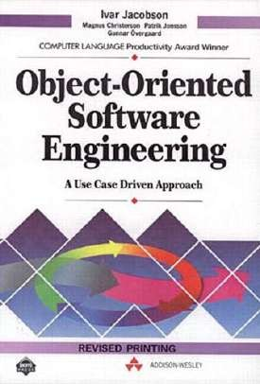

Where Do We Start?
•
•
What is the first story you would implement? Get it ready:
•
•
•
•
•
Immediately actionable Negotiable
Valuable Estimable Testable
•
Any non-functional requirements?
©2014ScrumInc.

Slide 21

Slicing User Story Options Based on Value
•
Slicing Requirements for Agile Success
Ellen Gottesdeiner and Mary Gorman. Better Software Jul/Aug 2010
Inspired by:
•
Chris Matts and Olav Masson on real options and feature injection
Bill Wake and others on story splitting
Jeff Sutherland and others on ready requirements
Dean Leffingwell on lean backlog
Mike Cohn on minimizing team handoffs
•
•
•
•
http://www.ebgconsulting.com/Pubs/Articles/SlicingRequirementsForAgileSuccess_Gottesdiener-Gorman_August2010.pdf
©2014ScrumInc.

Slide 22
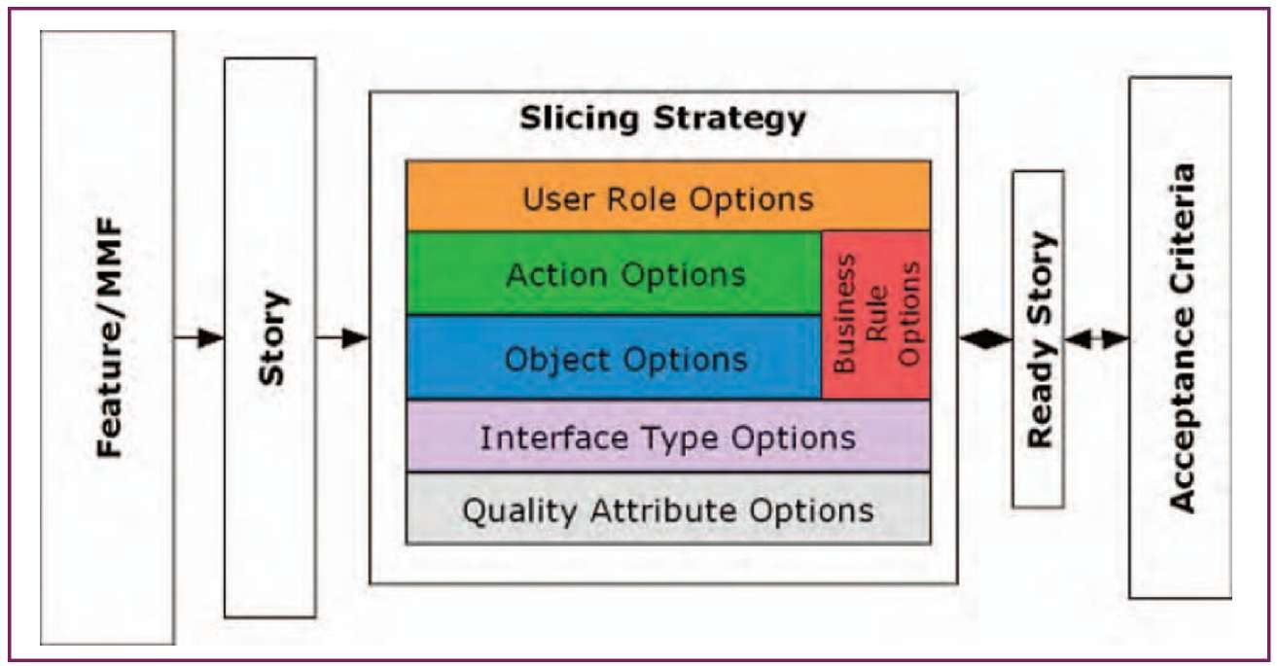
The Six Slicing Elements of a User Story
©2014ScrumInc.

Slide 23
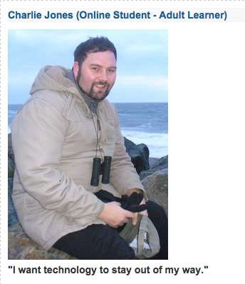
User Role Options: Types and State
What are possible user types?
Individual Buyer
Corporate Buyer
Club Member Buyer
Employee Buyer
What are possible user roles?
•
New
Existing
Anonymous
Archived
wiki.fluidproject.org
•
What combination yields the highest immediate value?
Individual Anonymous Buyer
©2014ScrumInc.

Slide 24

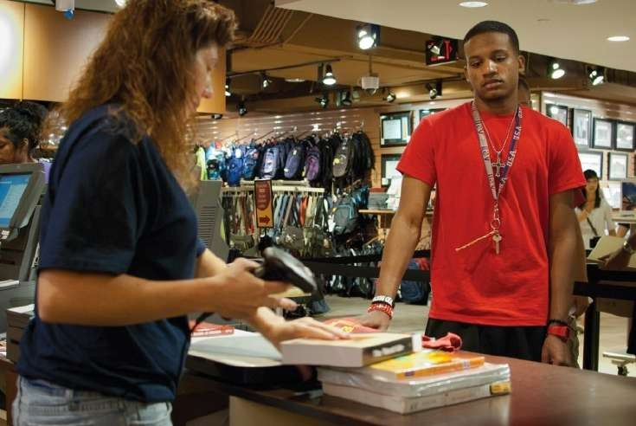
Buyer Action Items
•
To identify all possible buyer actions, consider “I want to buy a product.”
Ask the Product Owner what typically happens for an Individual Anonymous Buyer.
•
iowastatedaily.com
©2014ScrumInc.

Slide 25

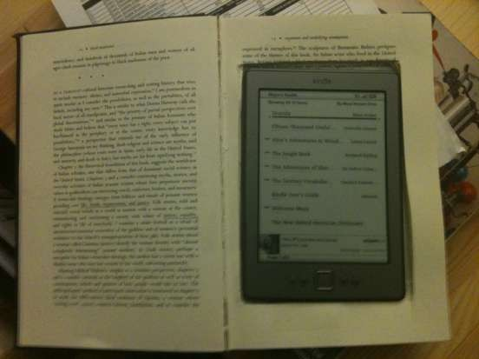
Buyer Action Items
To identify all possible buyer actions, consider “I want to buy a product.”
Ask the Product Owner what typically happens for an Individual Anonymous Buyer.
•
•
•
•
•
•
•
•
•
•
Verify product cost Calculate tax amount
Calculate total purchase amount Apply discount
Apply wrapping fee Arrange for shipping Secure payment Adjust inventory Generate receipt
Post payment to accounts receivable
library.barnard.edu
©2014ScrumInc.

Slide 26
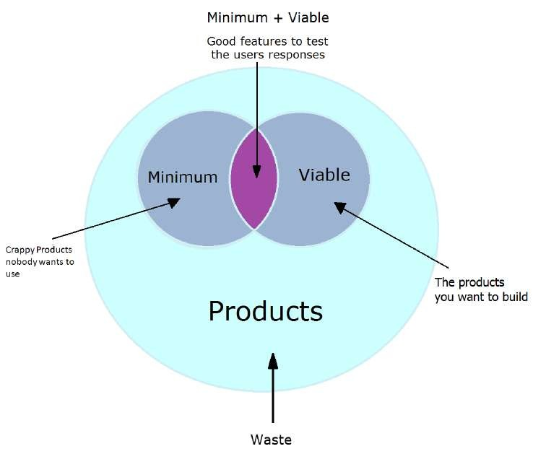
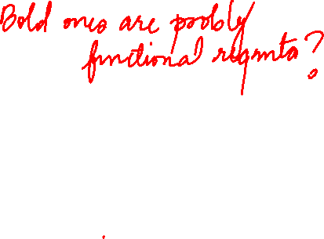
What are the Minimum Requirements for the Next Delivery Cycle?
•
•
•
•
•
•
•
•
•
•
Verify product cost
Calculate tax amount
Calculate total purchase amount
Apply discount Apply wrapping fee Arrange for shipping Secure payment Adjust inventory Generate receipt
Post payment to accounts receivable
startitup.co
©2014ScrumInc.

Slide 27
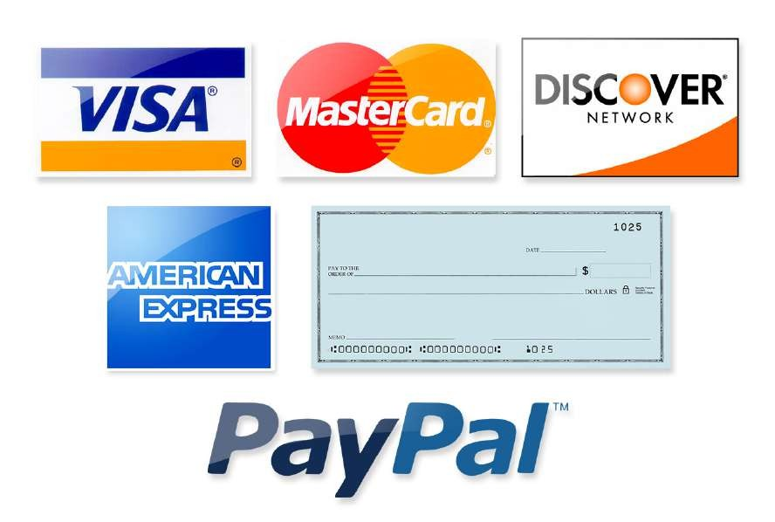
Data Option Types and States
•
•
•
What are product types? What are payment types? What are receipt types?
©2014ScrumInc.

Slide 28
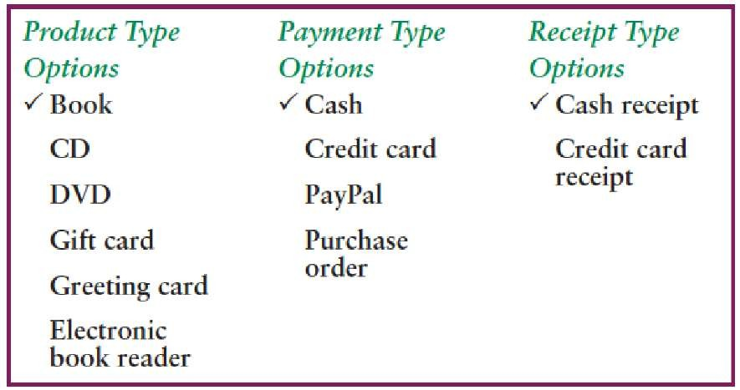
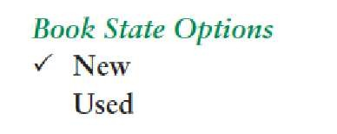
Data Option Types and States: Select for Value
©2014ScrumInc.

Slide 29

Sliced and Diced Story (so far)
•
As an individual anonymous buyer, I want to buy a new book with cash and receive a cash receipt.
©2014ScrumInc.

Slide 30
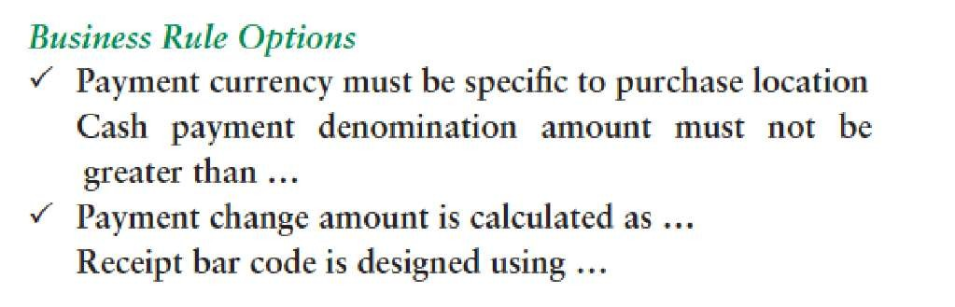


Step 4: Business Rule Options
©2014ScrumInc.

Slide 31
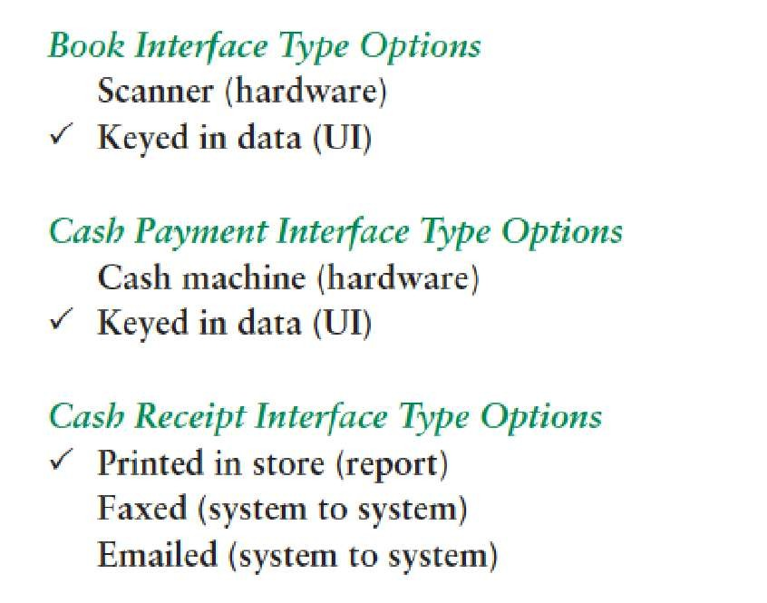
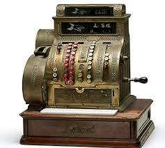
Exercise Step 5: Interface Type Options
dispatch.com
©2014ScrumInc.

Slide 32
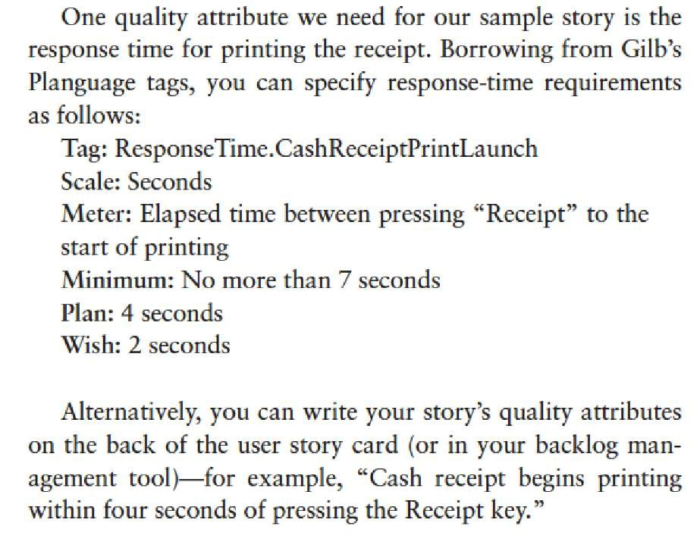

Quality Attribute Options
©2014ScrumInc.

Slide 33
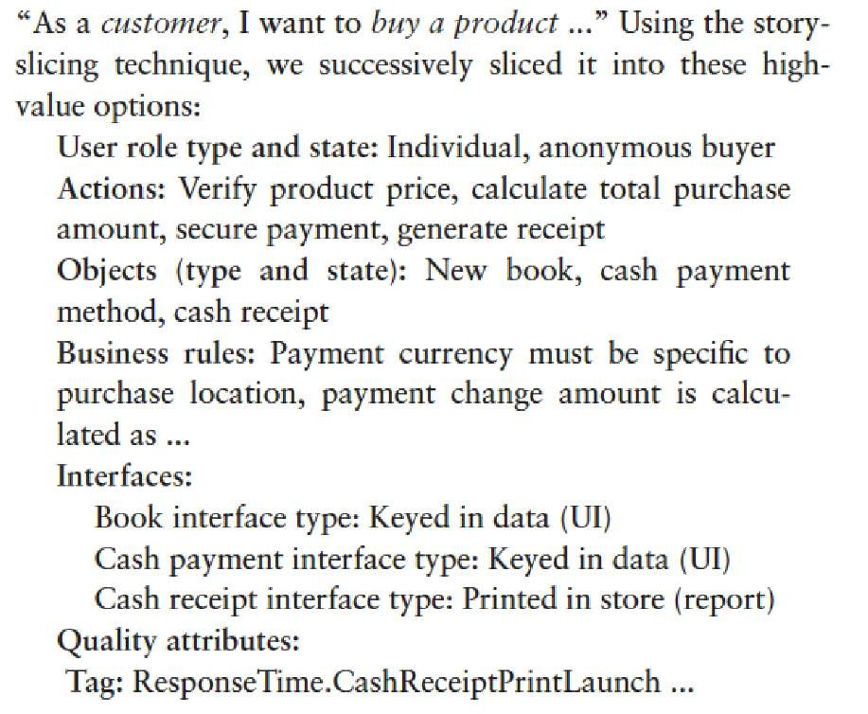


Sliced Story
Immediately Actionable
Negotiable
Valuable
Estimable
Sized to fit
Testable
©2014ScrumInc.

Slide 34
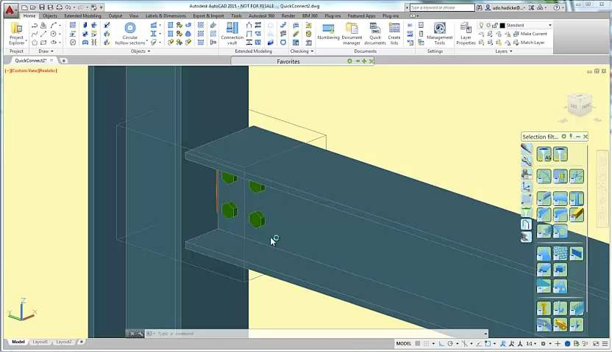

Example 2: Software
Autodesk Advance Steel + Revit Software
©2014ScrumInc.

Slide 35
Example 2: Software
Autodesk Advance Steel + Revit Software
As a steel detailer I need to model connections so that I can determine whether the structural design will interfere with the work of other building disciplines.
Acceptance criteria
Appearance of connection will be affected by current View level of detail
Upon connection creation the user will be able to see the created geometry at an appropriate level of detail
Geometry generated in Advance Steel will be dimensionally identical to geometry generated in Revit from the same parameter values.
▪
▪
©2014ScrumInc.

Slide 36
Example 2: Software
Autodesk Advance Steel + Revit Software
As a steel detailer, I need to select one or more steel structural members within Revit so that I can identify which structural members should be connected.
Acceptance criteria
Filter selection to structural items including both steel and concrete
Filter selection to structural items eligible for chosen connection type
Guided selection of eligible items
Guided selection of items in proper order
API access to eligible items
Identification of connecting ends based on location
©2014ScrumInc.

Slide 37
Example 2: Software
Autodesk Advance Steel + Revit Software
As a steel detailer, I need to select the type of connection to apply to one or more structural items so that I can begin making connection decisions based on an initial design.
Acceptance criteria
Initial availability of < 20 types from Advance Steel
Scalability to ensure eventual availability of approximately 300 types from Advance Steel
Ability to include type choices from third parties
New type choices will be created outside of Revit
©2014ScrumInc.

Slide 38
Example 2: Software
Autodesk Advance Steel + Revit Software
As a steel detailer, I need to understand the location, quantity, and diameter of the bolts at connections represented in Revit, so that I can further develop the connection detail.
Acceptance criteria
User should be able to measure distances: center of bolts to side of the plates, between bolts…etc.
©2014ScrumInc.

Slide 39
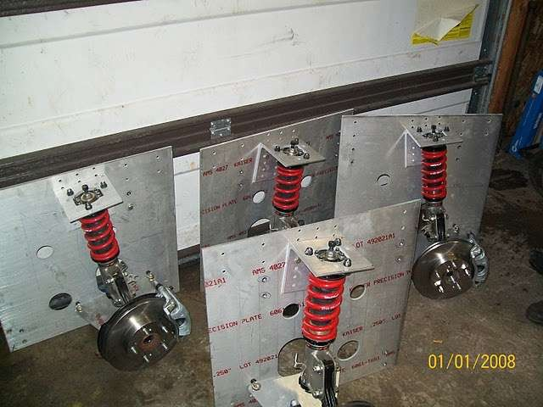





Example 3: Hardware
Wikispeed Car Suspension Module
User Story: “As a driver, I want to reduce suspension vibration so that I enjoy the ride more”
Key Story Elements
Adjust shocks to reduce stiffness of suspension module
I/O contract between “suspension” module and “Chassis” module not impacted
Therefore, all work can be completed within one 7-day sprint
Bolting pattern, drive train connection
and hydraulic interface represent the “I/O contract”
©2014ScrumInc.

Slide 40
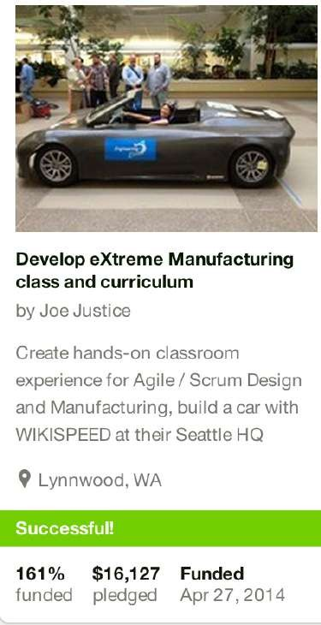
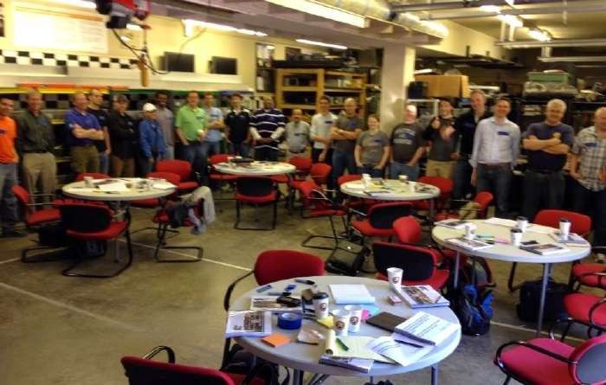
Example 4: Services
Context and Background
New Scrum Inc. class to teach the application of Scrum to both hardware and software
Not sure of market interest, but determined course would be held if it attracted at least 10 students to sign up
Decided to market on Kickstarter to test the water and go from there
©2014ScrumInc.

Slide 41







Example 4: Services
Industry Stack and Sample User Story Vertical Slice
“New Training” Stack
MVP: “Can we get 10 registrants in 60 days?”
Course Delivery
Sales and Customer Support
Marketing
Curriculum
Materials and Catering
Registration & Payment System
Logistics (Venue, Date & Time)
No “course delivery” activity needed to achieve MVP goals…comes in future stories
Be prepared for inevitable questions and help people enroll
Main push of MVP… get the word out
Thought through only enough for a provocative description…main course work comes after “go” decision
“Proof of concept” and budget-level
Need system capable of enrolling at least 10 people
Need to least select date and city for offering (venue nice)
©2014ScrumInc.

Slide 42
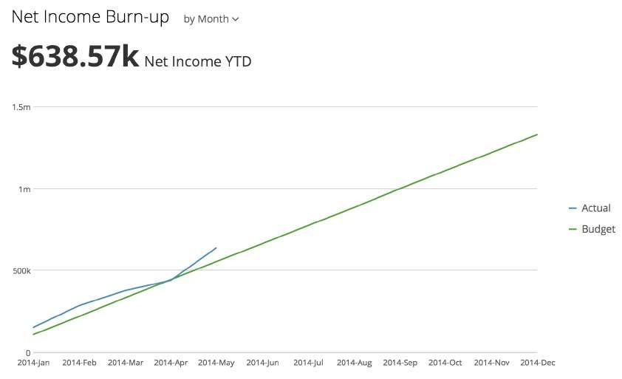
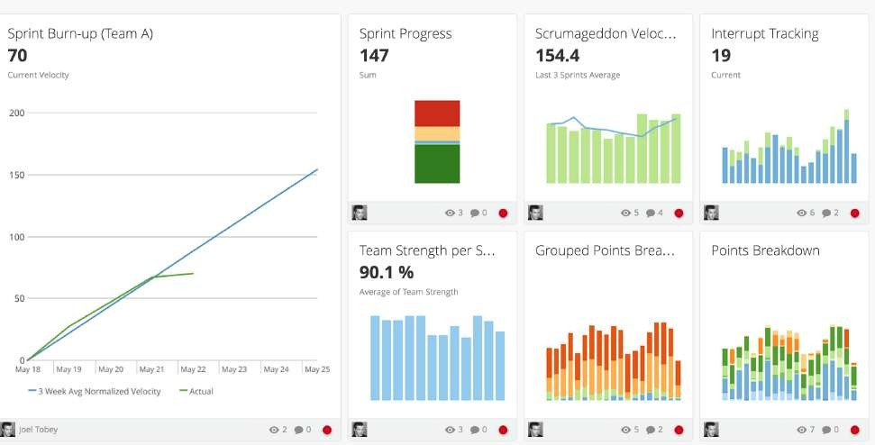
Example 5: Dashboard
Context and Background
Leadership must maintain visibility into org’s progress towards vision/goals.
To make course adjustments as needed to ensure progress
Informed decisions require relevant context and metrics
What are the right/wrong agile metrics to track?
How do we make sure those metrics are updated with the latest data?
How do we add and/or tweak them quickly and easily?
©2014ScrumInc.

Slide 43
Example 5: Dashboard
Dashboard Stack and Sample User Story Vertical Slice
User Story: As leadership, we must know how net income is burning up for the year so that we can forecast profits
“Dashboard” Stack
Metric KPI
Metrics Dashboard Interface Tool
Data analysis
Automated Data Aggregation / ERP
Raw Data Collection
Set up KPI visualization that clearly shows profit burn up
Create location in visualization tool for the KPI and establish data update cadence
Set up underlying analysis to calculate cumulative monthly net income data from revenues & costs
Automate aggregation of revenue and cost data into data warehouse
Establish method for collecting revenue and costs data for each transaction
©2014ScrumInc.

Slide 44
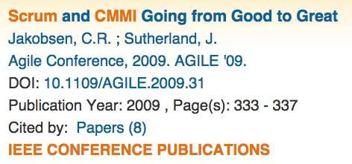
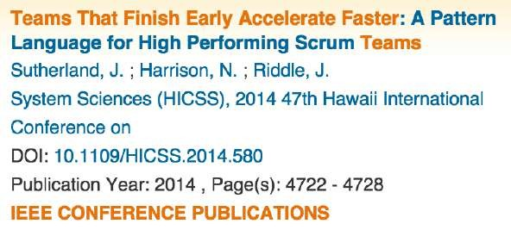
Conclusion
Writing good independent user stories is vital
They are not held up by external dependencies
They can be taken rapidly all the way to Done!
Getting stories done in the sprint will double team velocity
It takes both art and science to write stories well
•
The tips presented here can help get you started, but practice makes perfect
It is as important to recognize a good user story when you see one
©2014ScrumInc.

Slide 45



Questions?
©2014ScrumInc.

Slide 46
Stay Connected
E-mail
info@scruminc.com
Twitter, Facebook, and G+
@Scruminc, #Scrum, #Agile
Our Website
•
•
www.scruminc.com
check in for announcements, new content and services, book releases, and more!
ScrumLab
•
•
Scrumlab.scruminc.com
Articles, videos, papers on all things scrum
Online Courses
Advance your learning with our interactive online courses. Visit scrumlab to view upcoming topics.
©2014ScrumInc.

